Slide 1
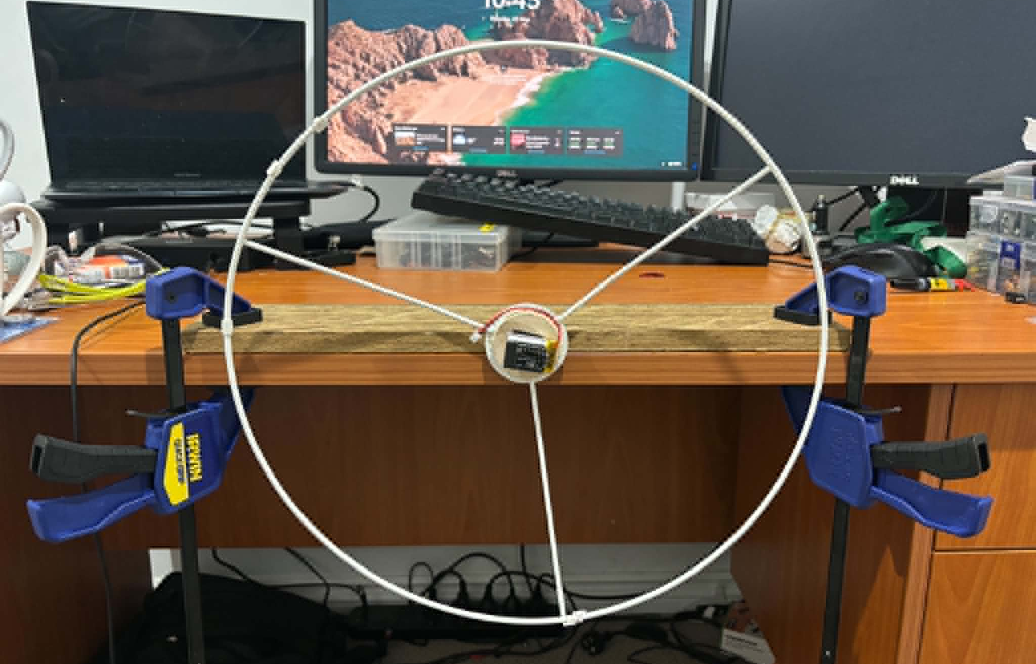
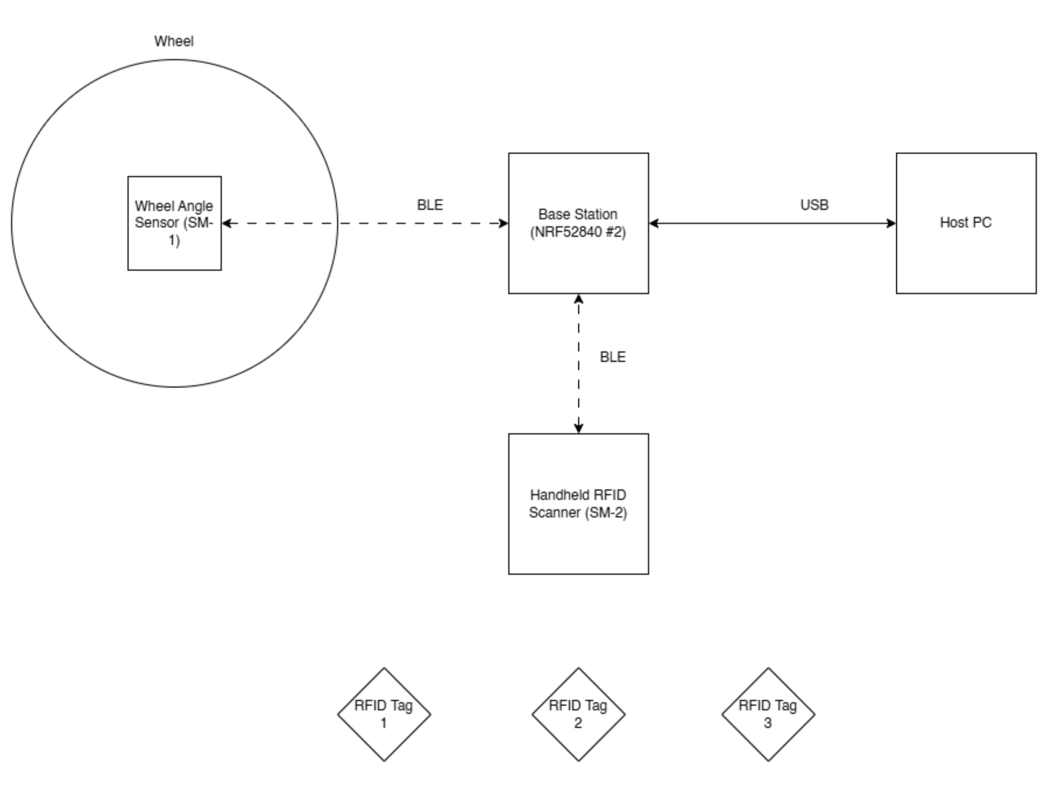
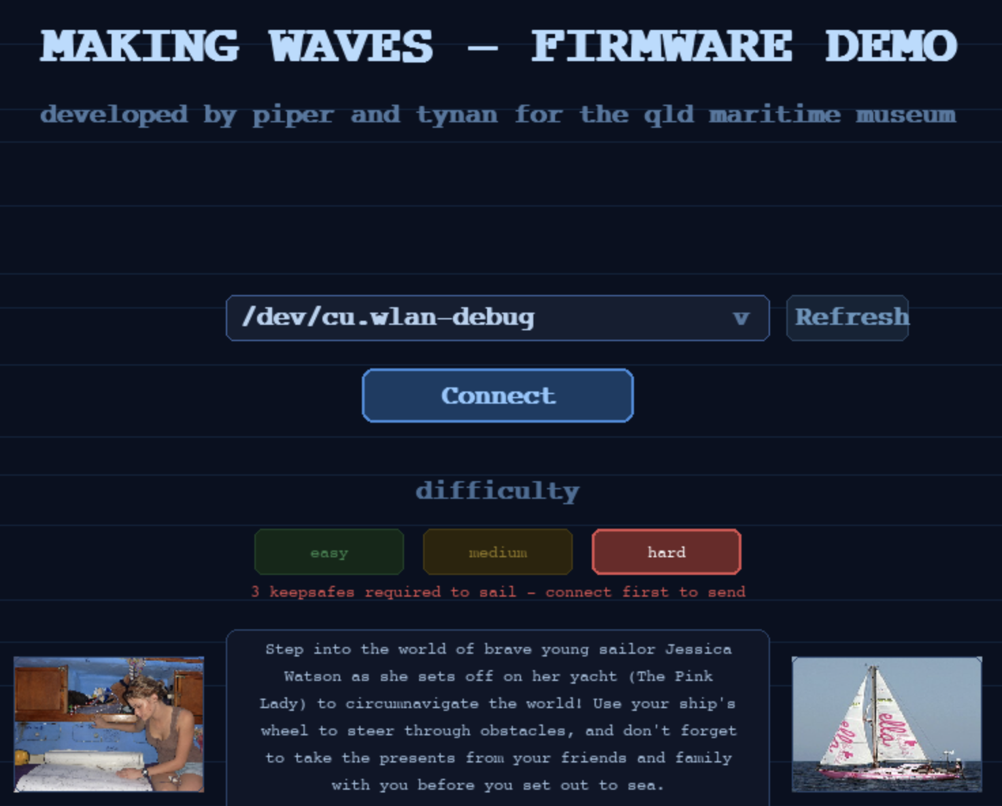
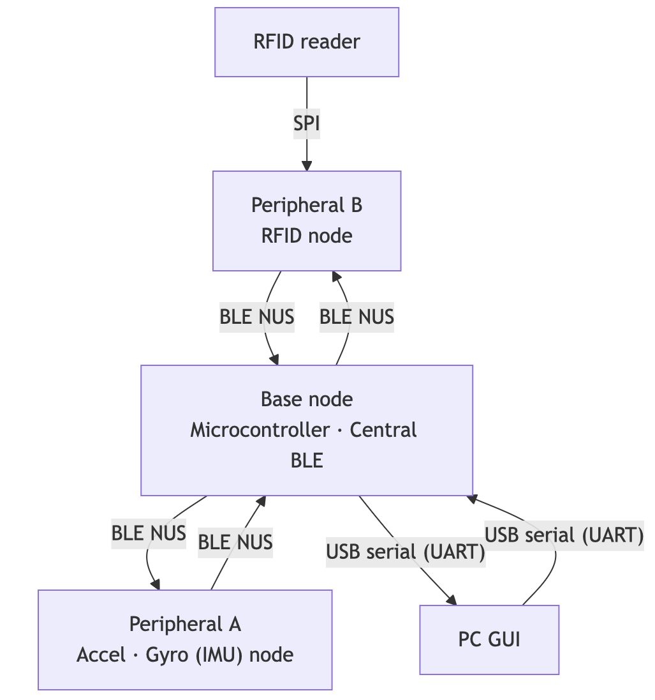
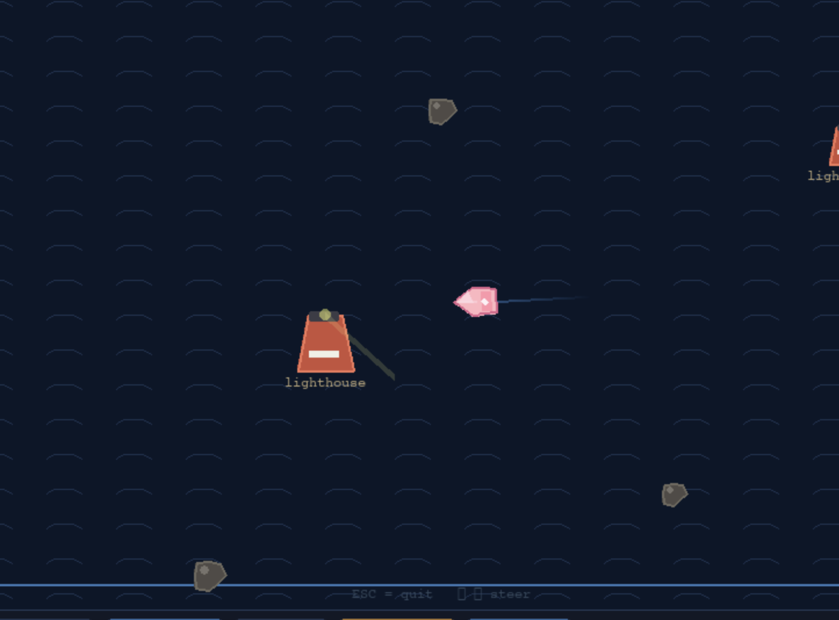
MAKING WAVES (BLUE - TETHYS)
Tynan Jones, 46387008, Piper Hofstee, 45805523
Introduction
The Queensland Maritime Museum is currently trying to increase visits from a teenage demographic.
The University of Queensland (UQ) has been approached for assistance with creating an interactive experience for their “Making Waves” exhibition. A previous group prototyped a boat simulator, driven by an old vessel’s wheel.
The overall objective of this project was to develop an interactive experience for the "Making Waves" exhibition, that involves the use of the boat wheel at the museum.
A Minimum Viable Product (MVP) has been developed to demonstrate a simplified version of the proposed full prototype for refinement purposes.
As an enhancement, inspired from the story of Jessica Watson’s mother hiding little cards, notes, and other trinkets around the boat, we have implemented an "easter egg hunt” that can be deployed in a physical space to encourage interaction and exploration of the museum’s exhibits.
System Overview
In the MVP, an Inertial Measurement Unit (IMU) was mounted to the centre of the wheel. The fusion of gyroscopic and accelerometer data will be used to determine the position of the wheel. This information was used to drive a virtual boat.
The Easter Egg Hunt was developed using a Radio-Frequency Identification (RFID) system. The user finds RFID fobs in the physical space and scans them with a receiver, creating a checkpoint-based data muling system. For the MVP, these collectibles are used to unlock control of the virtual boat.
The system communicates over a number of
wired and wireless communication protocols, forming a network of 4x nodes; 2x peripheral nodes, a central base node and a PC GUI which displays information in a format useful to a user. The PC was also where the game was to be played. Communication between all nodes is fully duplex, allowing for control and communication of peripheral sensors.
Block Diagrams
Figure 1: Device Hardware Configuration
Figure 2: Communication Protocol
Findings
Much time was spent in the planning phase, so the end product did not differ greatly from the planned implementation.
It was found useful to make the disconnection/reconnection of nodes more robust, as sometimes a node would disconnect during operation.
A fast transmit rate was also required from the IMU node to allow for real time steering.
When we began testing the IMU with a battery, we found that the BLE system consistently dropped out. The root cause was found to be a lower transmission power from the IMU, likely caused by a poor voltage reference. The solution was to increase the transmit power until no dropouts were observed.
References and Acknowledgements
We would like to thank the team at the QLD Maritime Museum, in particular Sanjana and Marie, for their assistance and time in developing this project.
[1] Embedded Expert, "RC522 RFID Reader with nRF52840 and Zephyr RTOS," Embedded Expert Blog, [Online]. Available: https://blog.embeddedexpert.io/?p=768. [Accessed: 2025].
[2] Pygame Community, "Pygame — Python Game Development," Pygame Library Documentation, [Online]. Available: https://www.pygame.org.
[3] Zephyr Project, "Zephyr Project Documentation," The Linux Foundation, [Online]. Available: https://docs.zephyrproject.org.
Figure 3: Physical Steering Wheel Rig
Figure 4: Startup screen of device GUI
Figure 5: Gameplay still of boat navigation on GUI

